Slide 1
Unit -4.4

Slide 2
Failure Classification
To find that where the problem has occurred, we generalize a failure into the following categories:
Transaction failure
System crash
Disk failure
1. Transaction failure
The transaction failure occurs when it fails to execute or when it reaches a point from where it can't go any further. If a few transaction or process is hurt, then this is called as transaction failure.
Reasons for a transaction failure could be –
Logical errors: If a transaction cannot complete due to some code error or an internal error condition, then the logical error occurs.
Syntax error: It occurs where the DBMS itself terminates an active transaction because the database system is not able to execute it.
For example, The system aborts an active transaction, in case of deadlock or resource unavailability.
2. System Crash
System failure can occur due to power failure or other hardware or software failure. Example: Operating system error.
Fail-stop assumption: In the system crash, non-volatile storage is assumed not to be corrupted.
3. Disk Failure
It occurs where hard-disk drives or storage drives used to fail frequently. It was a common problem in the early days of technology evolution.
Disk failure occurs due to the formation of bad sectors, disk head crash, and unreachability to the disk or any other failure, which destroy all or part of disk storage.

Slide 3
Log-Based Recovery
The log is a sequence of records. Log of each transaction is maintained in some stable storage so that if any failure occurs, then it can be recovered from there.
If any operation is performed on the database, then it will be recorded in the log.
But the process of storing the logs should be done before the actual transaction is applied in the database.
Let's assume there is a transaction to modify the City of a student.
The following logs are written for this transaction.
When the transaction is initiated, then it writes 'start' log. <Tn, Start>
When the transaction modifies the City from 'Noida' to 'Bangalore', then another log is written to the file <Tn, City, 'Noida', 'Bangalore' >
When the transaction is finished, then it writes another log to indicate the end of the transaction. <Tn, Commit>

Slide 4
There are two approaches to modify the database:
1. Deferred database modification:
The deferred modification technique occurs if the transaction does not modify the database until it has committed.
In this method, all the logs are created and stored in the stable storage, and the database is updated when a transaction commits.
2. Immediate database modification:
The Immediate modification technique occurs if database modification occurs while the transaction is still active.
In this technique, the database is modified immediately after every operation. It follows an actual database modification.
Recovery using Log records
When the system is crashed, then the system consults the log to find which transactions need to be undone and which need to be redone.
If the log contains the record <Ti, Start> and <Ti, Commit> or <Ti, Commit>, then the Transaction Ti needs to be redone.
If log contains record<T_{n}, Start> but does not contain the record either <Ti, commit> or <Ti, abort>, then the Transaction Ti needs to be undone.

Slide 5
Checkpoint
The checkpoint is a type of mechanism where all the previous logs are removed from the system and permanently stored in the storage disk.
The checkpoint is like a bookmark. While the execution of the transaction, such checkpoints are marked, and the transaction is executed then using the steps of the transaction, the log files will be created.
When it reaches to the checkpoint, then the transaction will be updated into the database, and till that point, the entire log file will be removed from the file. Then the log file is updated with the new step of transaction till next checkpoint and so on.
The checkpoint is used to declare a point before which the DBMS was in the consistent state, and all transactions were committed.

Slide 6
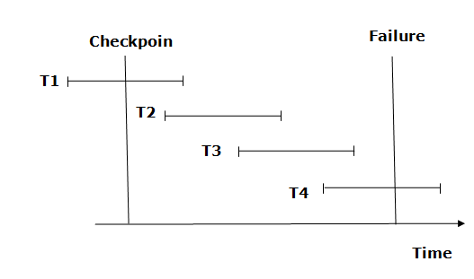
Recovery using Checkpoint
In the following manner, a recovery system recovers the database from this failure:
The recovery system reads log files from the end to start. It reads log files from T4 to T1.
Recovery system maintains two lists, a redo-list, and an undo-list.
The transaction is put into redo state if the recovery system sees a log with <Tn, Start> and <Tn, Commit> or just <Tn, Commit>. In the redo-list and their previous list, all the transactions are removed and then redone before saving their logs.
For example: In the log file, transaction T2 and T3 will have <Tn, Start> and <Tn, Commit>. The T1 transaction will have only <Tn, commit> in the log file. That's why the transaction is committed after the checkpoint is crossed. Hence it puts T1, T2 and T3 transaction into redo list.
The transaction is put into undo state if the recovery system sees a log with <Tn, Start> but no commit or abort log found. In the undo-list, all the transactions are undone, and their logs are removed.
For example: Transaction T4 will have <Tn, Start>. So T4 will be put into undo list since this transaction is not yet complete and failed amid.

Slide 7
Deadlock in DBMS
A deadlock is a condition where two or more transactions are waiting indefinitely for one another to give up locks. Deadlock is said to be one of the most feared complications in DBMS as no task ever gets finished and is in waiting state forever.
For example: In the student table, transaction T1 holds a lock on some rows and needs to update some rows in the grade table. Simultaneously, transaction T2 holds locks on some rows in the grade table and needs to update the rows in the Student table held by Transaction T1.
Now, the main problem arises. Now Transaction T1 is waiting for T2 to release its lock and similarly, transaction T2 is waiting for T1 to release its lock. All activities come to a halt state and remain at a standstill. It will remain in a standstill until the DBMS detects the deadlock and aborts one of the transactions.

Slide 8
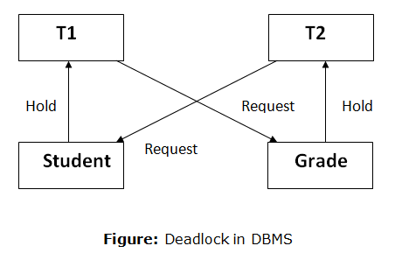

Slide 9
Deadlock Avoidance
When a database is stuck in a deadlock state, then it is better to avoid the database rather than aborting or restating the database. This is a waste of time and resource.
Deadlock avoidance mechanism is used to detect any deadlock situation in advance. A method like "wait for graph" is used for detecting the deadlock situation but this method is suitable only for the smaller database. For the larger database, deadlock prevention method can be used.
Deadlock Detection
In a database, when a transaction waits indefinitely to obtain a lock, then the DBMS should detect whether the transaction is involved in a deadlock or not. The lock manager maintains a Wait for the graph to detect the deadlock cycle in the database.
Wait for Graph
This is the suitable method for deadlock detection. In this method, a graph is created based on the transaction and their lock. If the created graph has a cycle or closed loop, then there is a deadlock.
The wait for the graph is maintained by the system for every transaction which is waiting for some data held by the others. The system keeps checking the graph if there is any cycle in the graph.

Slide 10
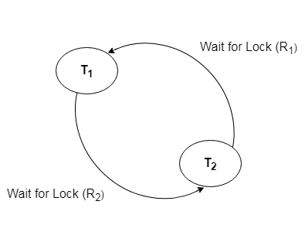
The wait for a graph for the above scenario is shown below:

Slide 11
Deadlock Prevention
Deadlock prevention method is suitable for a large database. If the resources are allocated in such a way
that deadlock never occurs, then the deadlock can be prevented.
The Database management system analyzes the operations of the transaction whether they can create a
deadlock situation or not. If they do, then the DBMS never allowed that transaction to be executed.
Wait-Die scheme
In this scheme, if a transaction requests for a resource which is already held with a conflicting lock by another transaction
then the DBMS simply checks the timestamp of both transactions. It allows the older transaction to wait until the resource
is available for execution.
Let's assume there are two transactions Ti and Tj and let TS(T) is a timestamp of any transaction T. If T2 holds a lock by
some other transaction and T1 is requesting for resources held by T2 then the following actions are performed by DBMS:
Check if TS(Ti) < TS(Tj) - If Ti is the older transaction and Tj has held some resource, then Ti is allowed to wait until the data-
item is available for execution. That means if the older transaction is waiting for a resource which is locked by the younger
transaction, then the older transaction is allowed to wait for resource until it is available.
Check if TS(T_{i}) < TS(Tj) - If Ti is older transaction and has held some resource and if Tj is waiting for it, then Tj is killed and
restarted later with the random delay but with the same timestamp.
Wound wait scheme
In wound wait scheme, if the older transaction requests for a resource which is held by the younger transaction, then older transaction forces younger one to kill the transaction and release the resource. After the minute delay, the younger transaction is restarted but with the same timestamp.
If the older transaction has held a resource which is requested by the Younger transaction, then the younger transaction is asked to wait until older releases it.

